Slide 1

Stock Analysis
Kyle Breda
Eduardo Calles
Anand Krishnan
Sarah Rupprecht

Slide 2





Slide 4
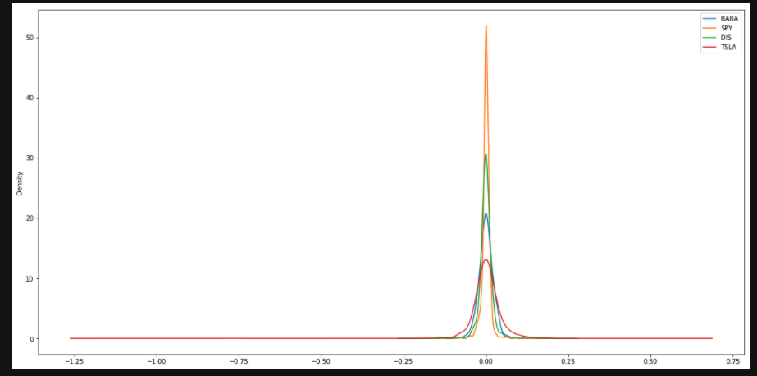

Slide 6
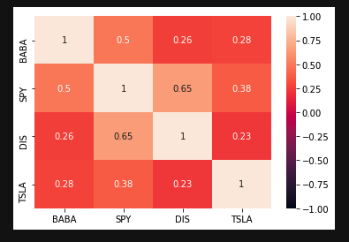

Slide 7
MC: Initial Investment of $10,000 over the next year
Stock | Min | Max
SPY | $4,758.51 | $69,339.08
BABA | $3,776.86 | $96,441.37
DIS | $7,703.55 | $51,250.86
TSLA | $1,214.95 | $75,128.56

Slide 8
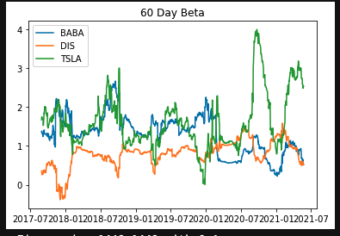

Slide 9
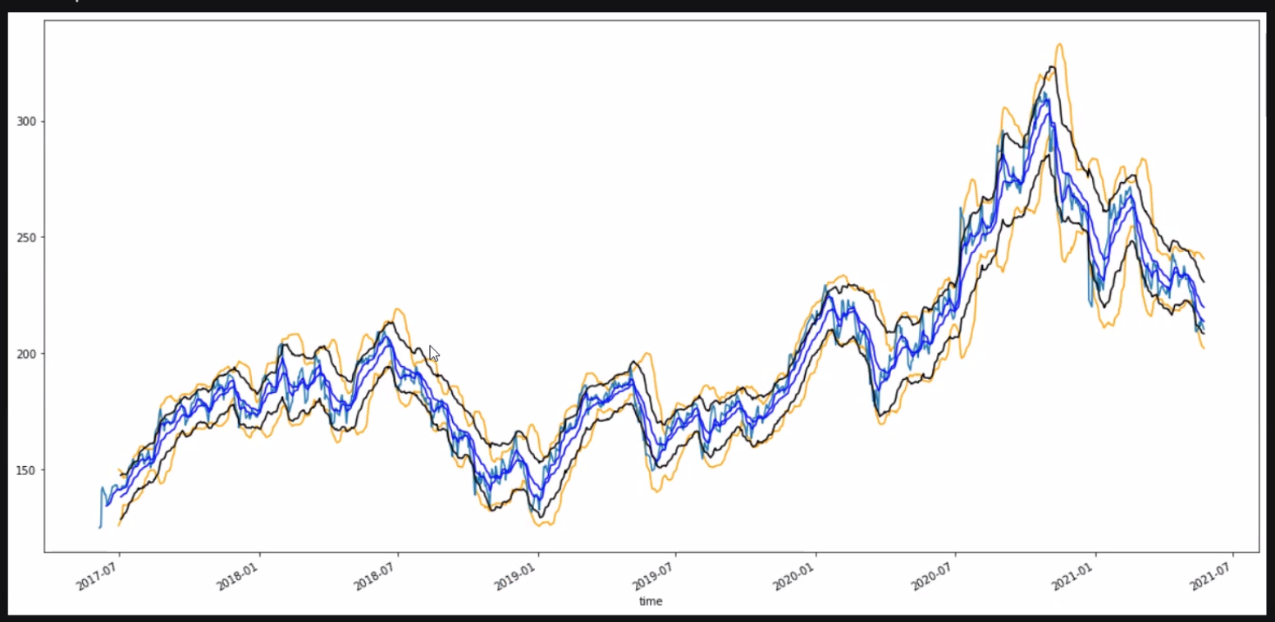

Slide 10
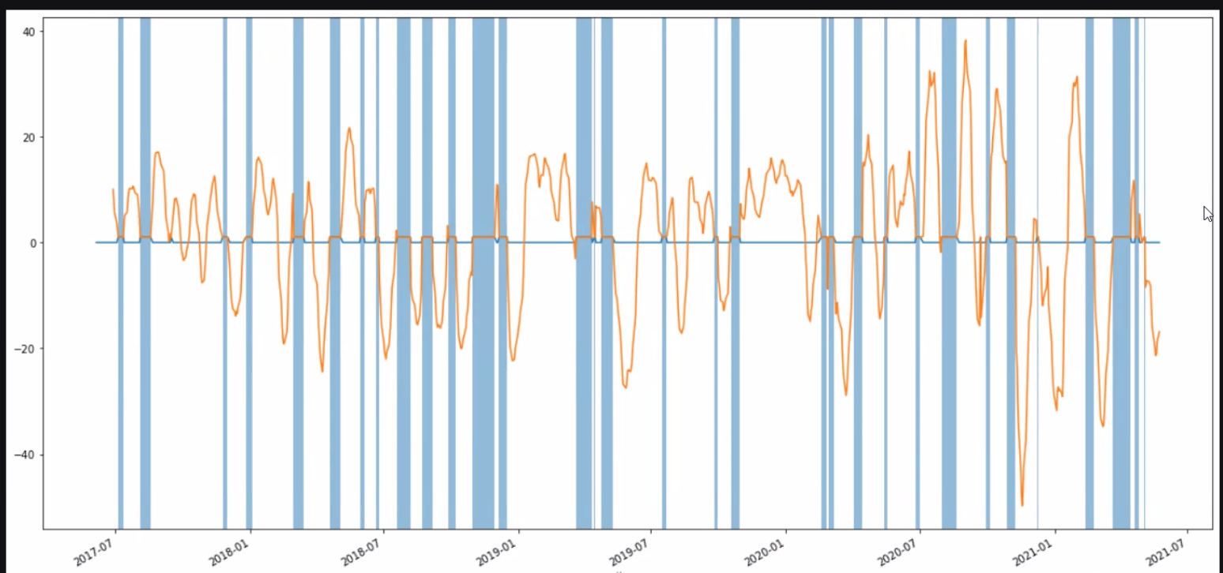

Slide 11
Summary
We found based on our Monte Carlo simulation, there's a 95% chance an initial investment of $10,000 in BABA over the next year will end within in the range of $3,776.86 and $96,441.37; in DIS over the next year will end within in the range of $7,703.55 and $51,250.86; in TSLA over the next year will end within in the range of $1,214.95 and $75,1289.56; in SPY over the next year will end within in the range of $4,758.51 and $69,339.08. Based on these results BABA and TSLA show to be out performing SPY.

